Slide 1
COSC 304 lab10
Group 111, Kenichiro Anderson, Kevin Kim
kevinkim990503@gmail.com
andersonken048@gmail.com

Slide 2
Customers By region
In our analysis we are required to negate the findings of 2023 as we haven’t finished the last quarter, so we projected the years 2023 and 2024 due to this. These metrics are important as we can see what provinces we need to expand a warehouse to or what provinces need more sales help.

Slide 3
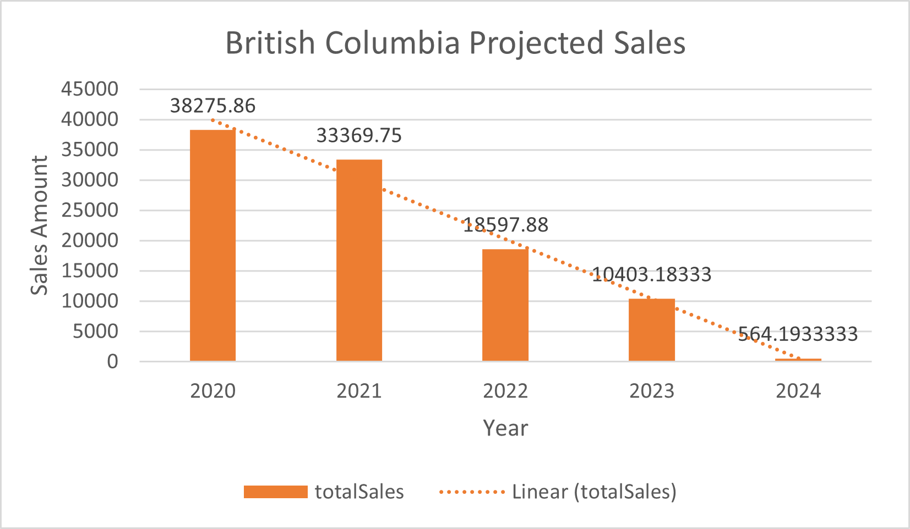
British Columbia predicted sales for 2023, 2024

Slide 4
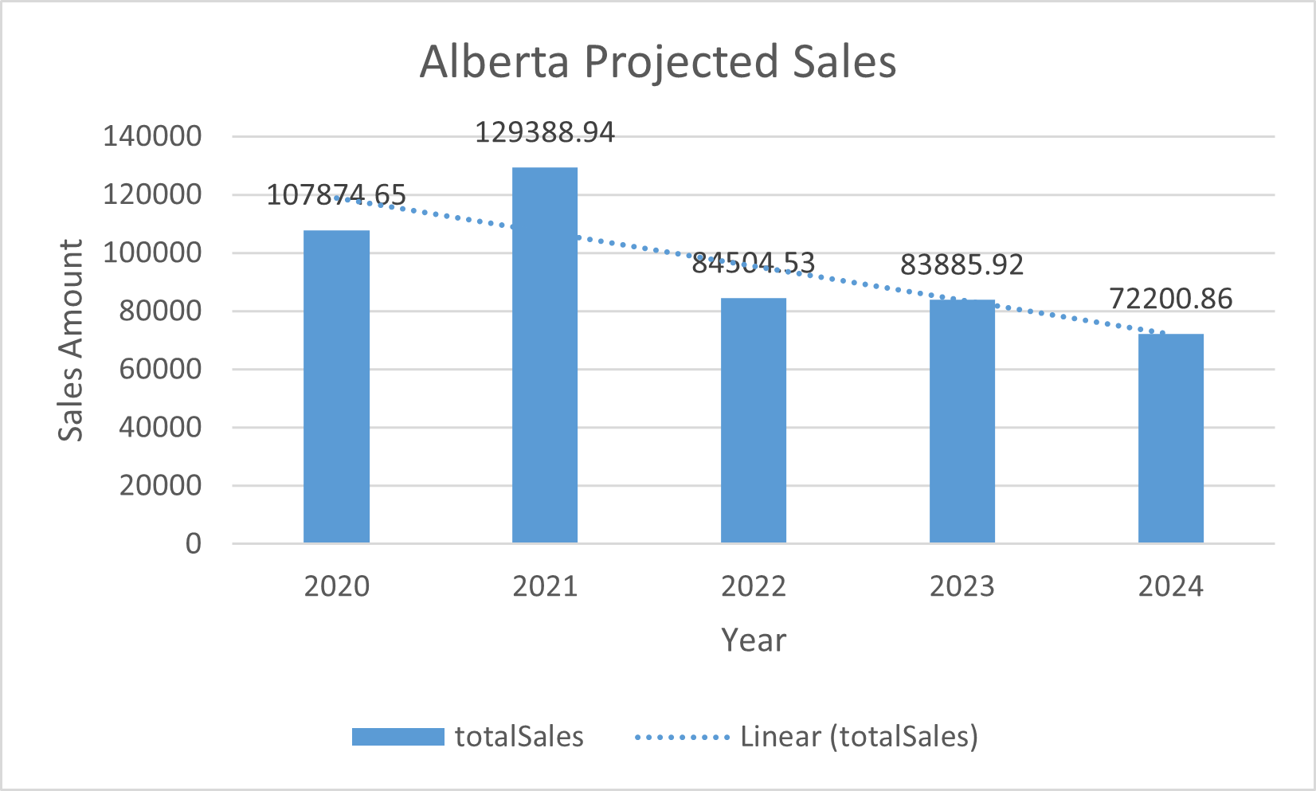
Alberta predicted sales for 2023, 2024

Slide 5
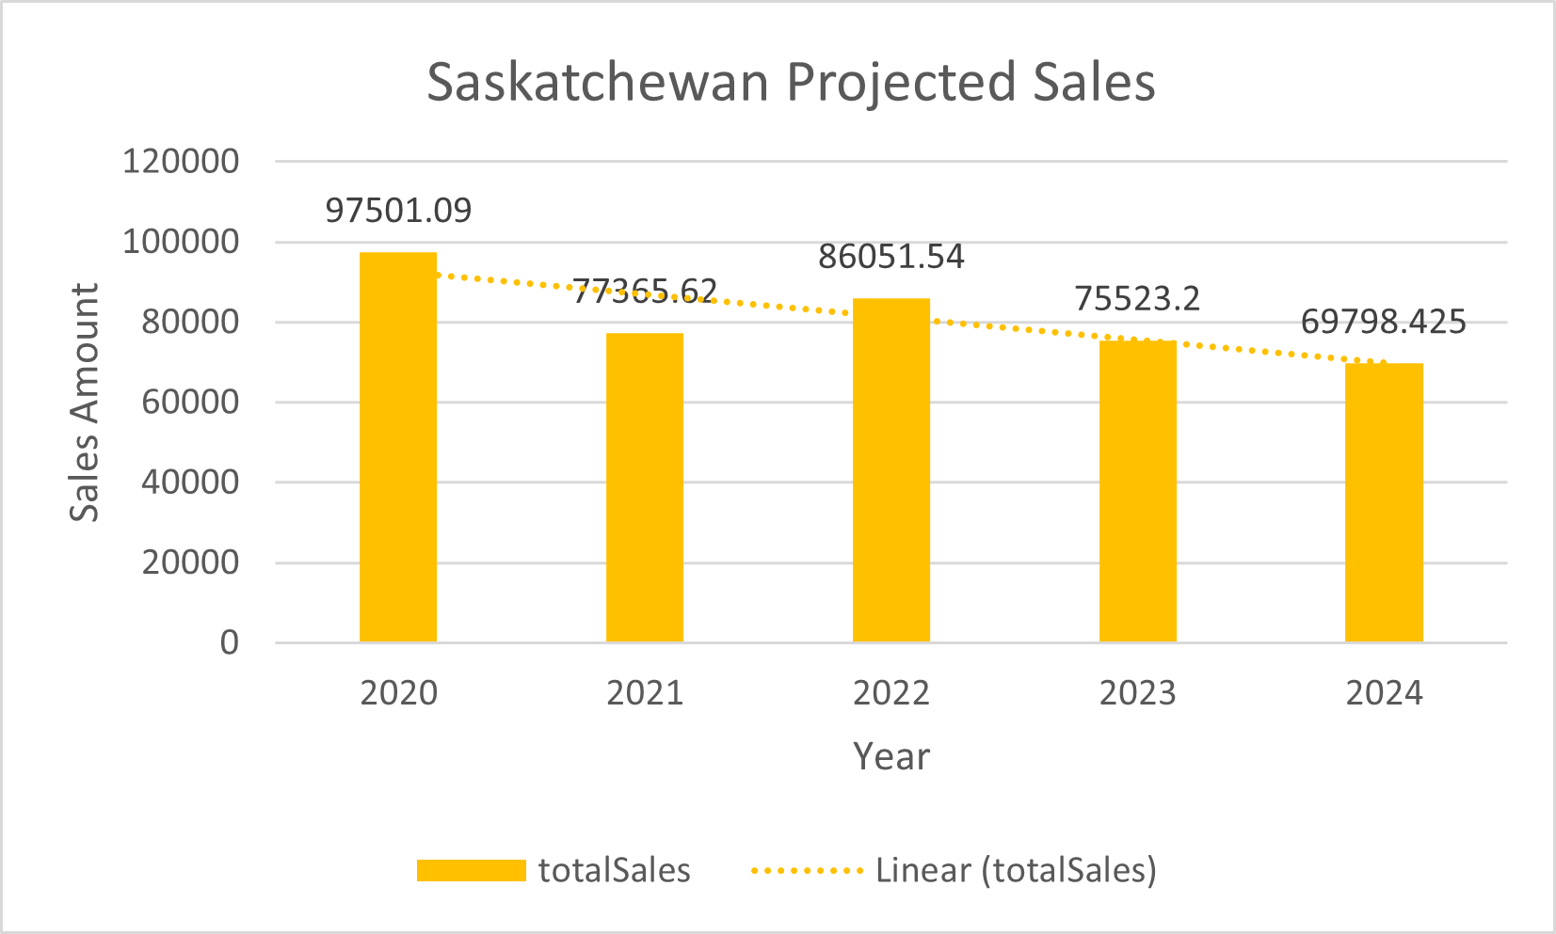
Saskatchewan predicted sales for 2023, 2024

Slide 6
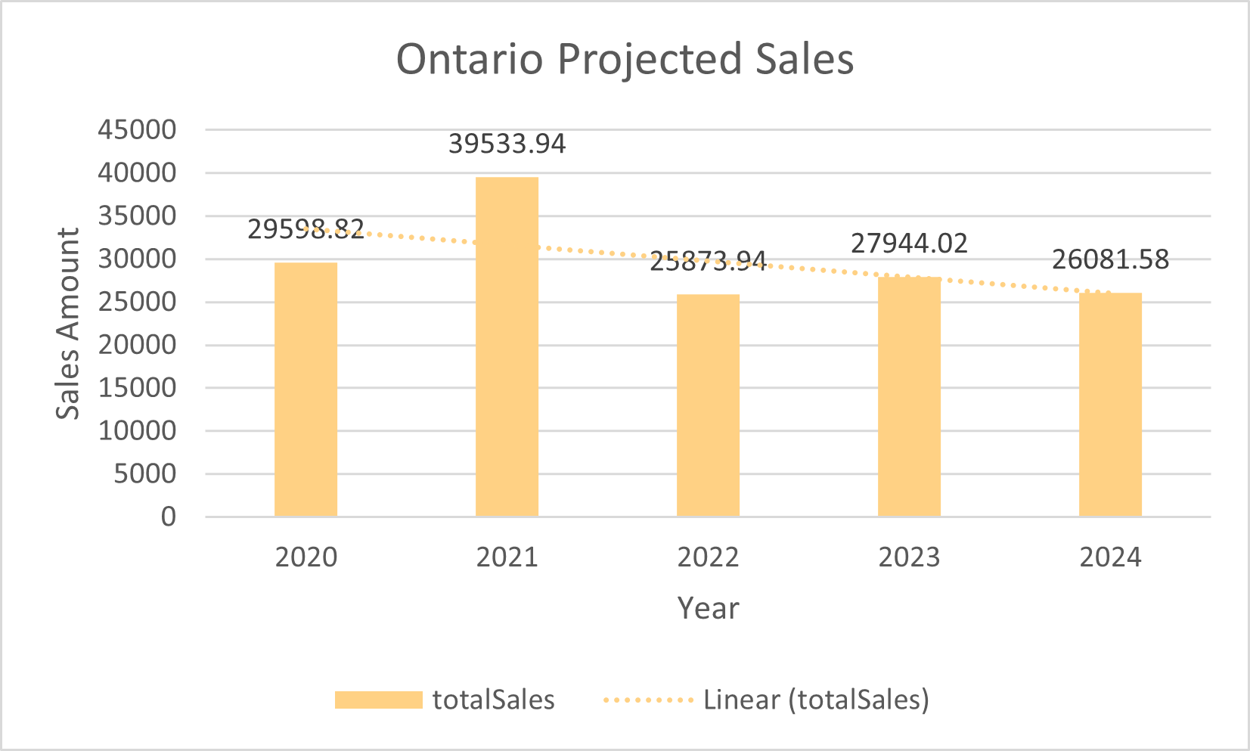
Ontario predicted sales for 2023, 2024

Slide 7
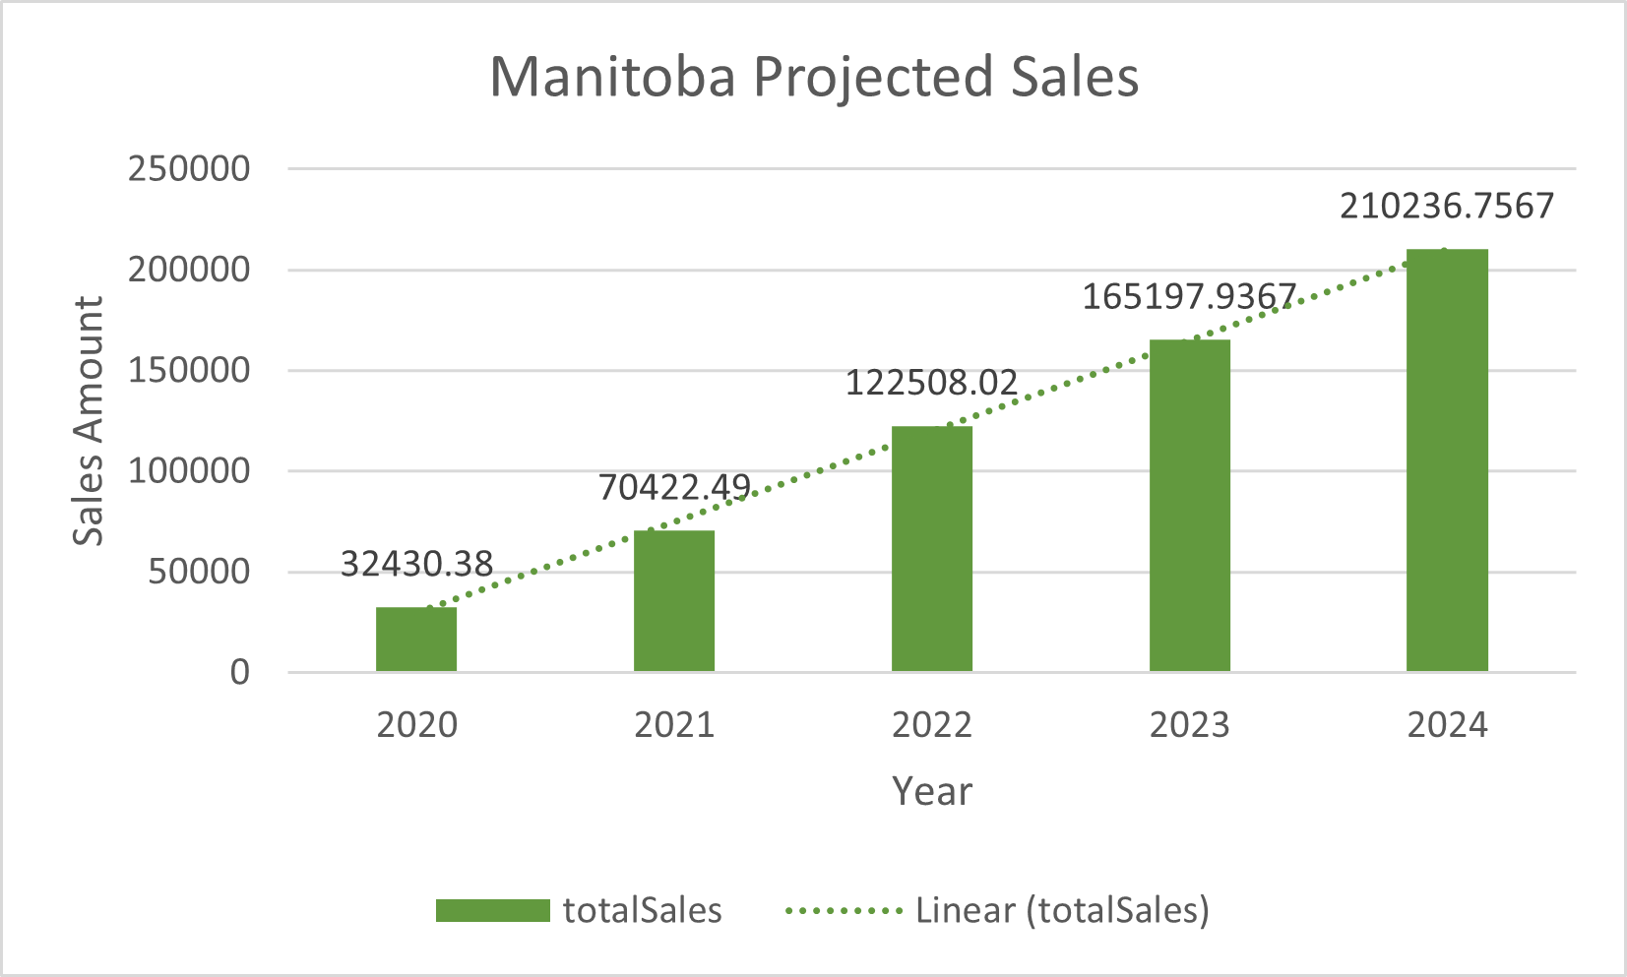
Manitoba predicted sales for 2023, 2024

Slide 8
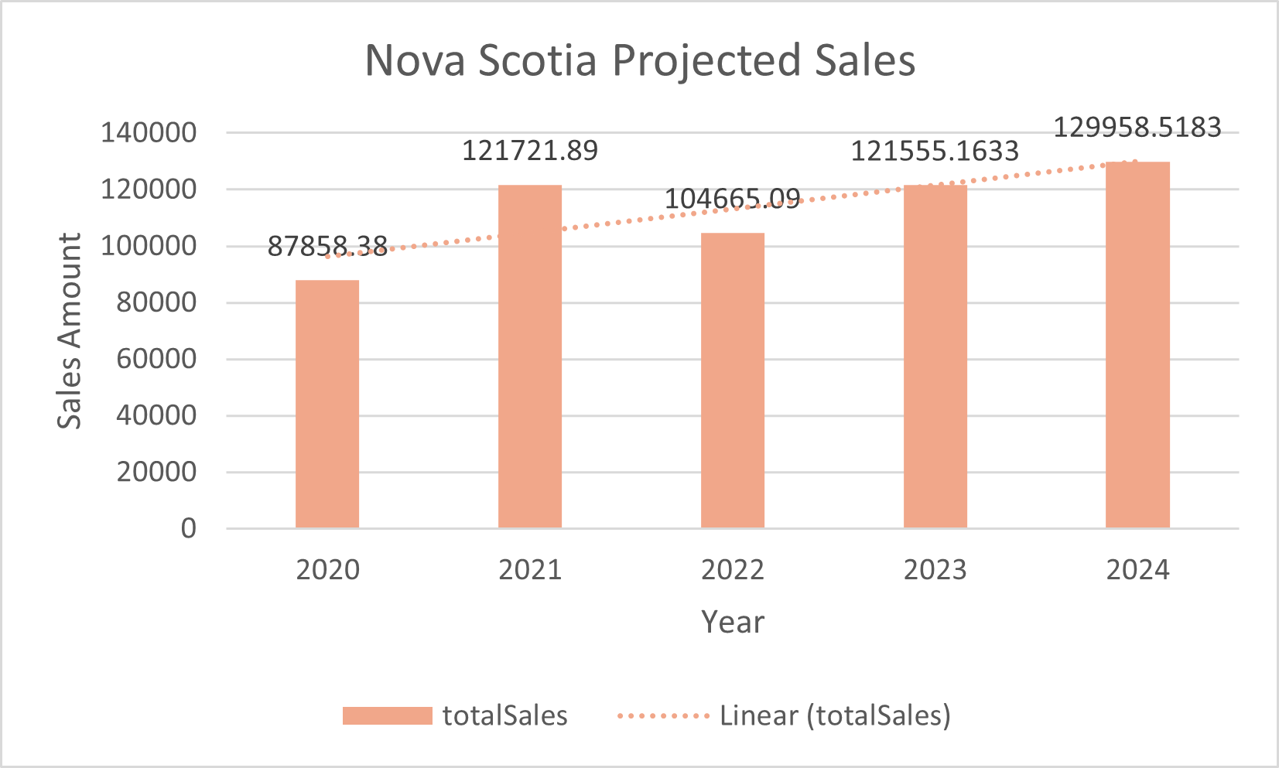
Nova Scotia Predicted Sales 2023,2024

Slide 9
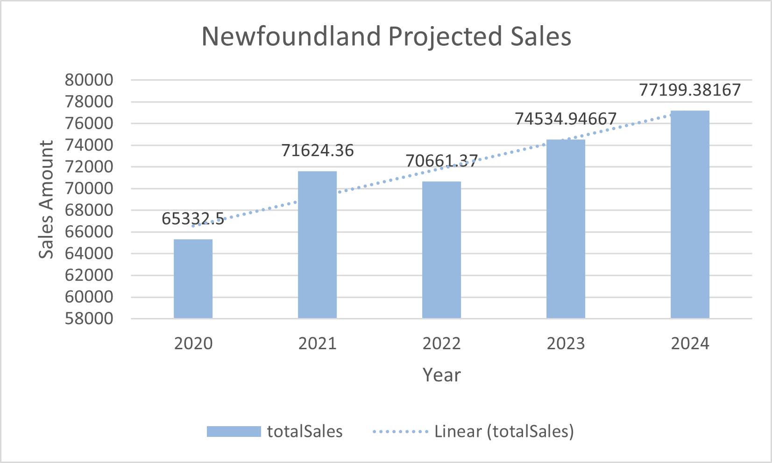
Newfoundland Predicted Sales 2023,2024

Slide 10
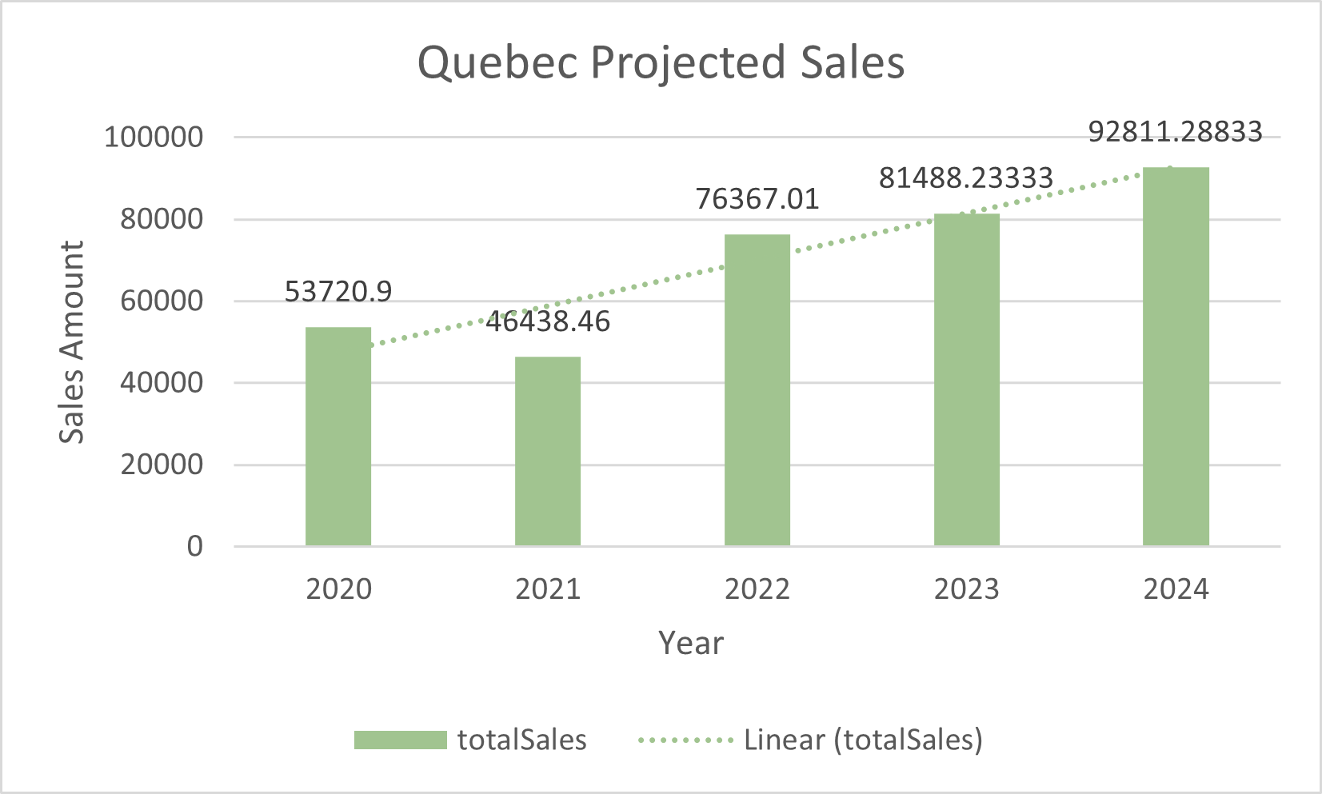
Quebec Predicted Sales 2023,2024

Slide 11
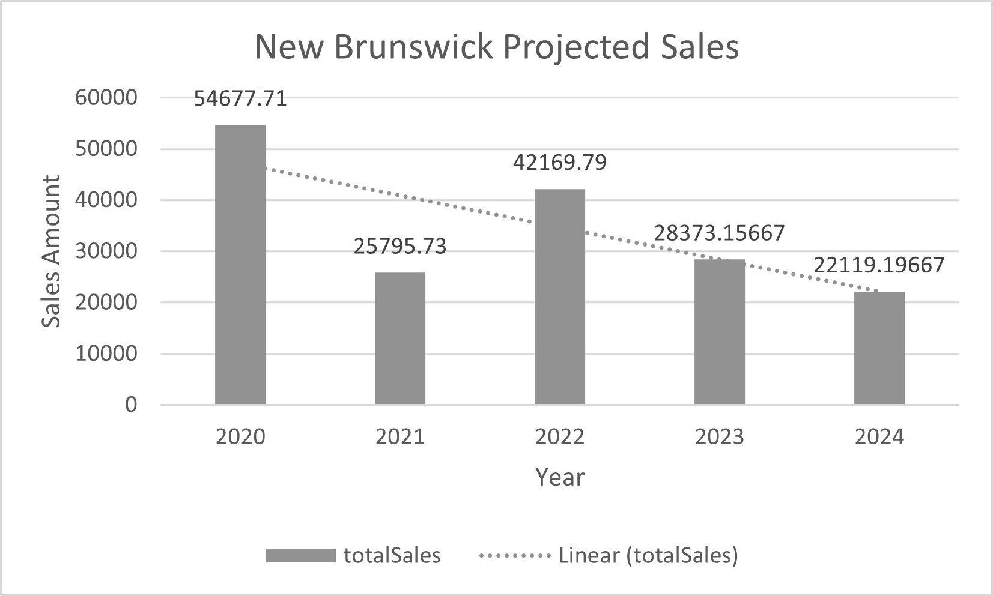
New Brunswick Predicted Sales 2023,2024

Slide 12
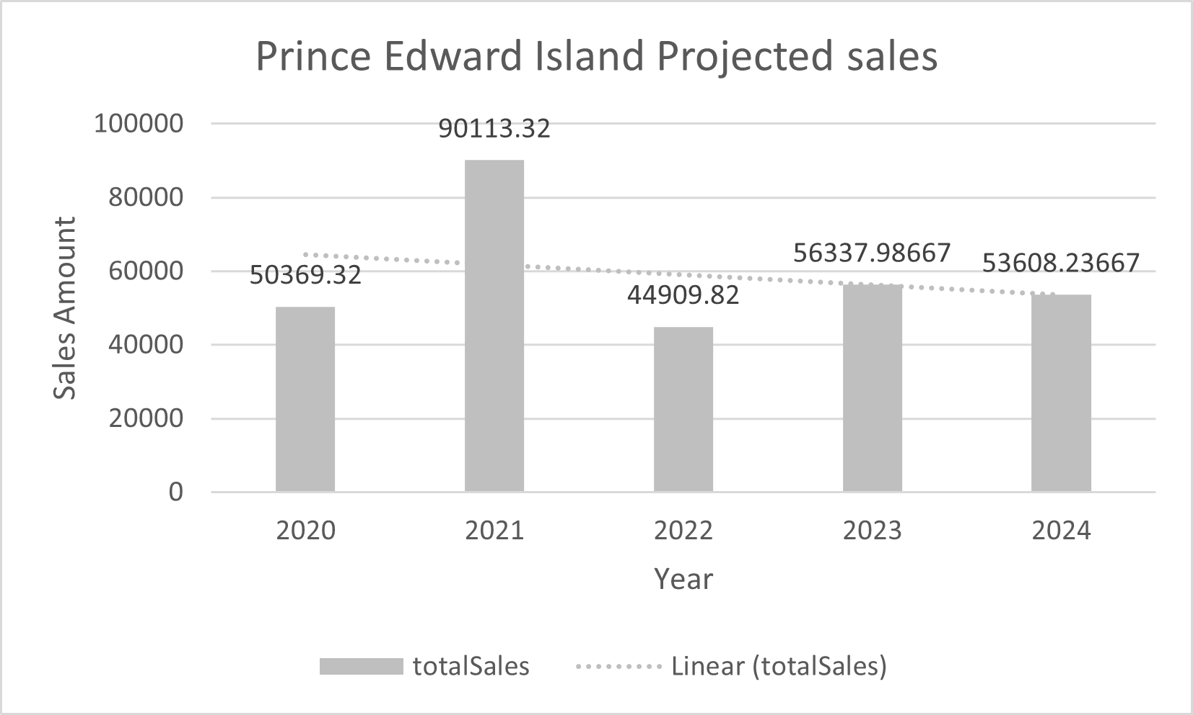
Prince Edward island Predicted Sales 2023,2024

Slide 13
MANAGEMENT SUMMARY:
Since Manitoba, Nova Scotia, Newfoundland and Quebec all have positive projections we do not need to make any changes, as long as we can stay consistent with the projected growth, we shouldn’t need much help. Perhaps if we hit these projection numbers, we may need to expand our sales team and possibly make more warehouses near these hot spots.
As for British Columbia, Alberta, Saskatchewan, Ontario, New Brunswick and Prince Edward island, we may need to have another meeting on this and examine our struggles with these provinces.

Slide 14
Best and worst products
To calculate the best and worst products, we found the top 5 products and the bottom 5 across all of the years. We Queried those 10 products to find their sales revenue over all the years they were sold, after this we then did the projections of the products.
The reasoning behind this was that some products will not be the top for all 5 years in a row thus it was impossible to query and find these products, so we found the top products and bottom over all of the years

Slide 15
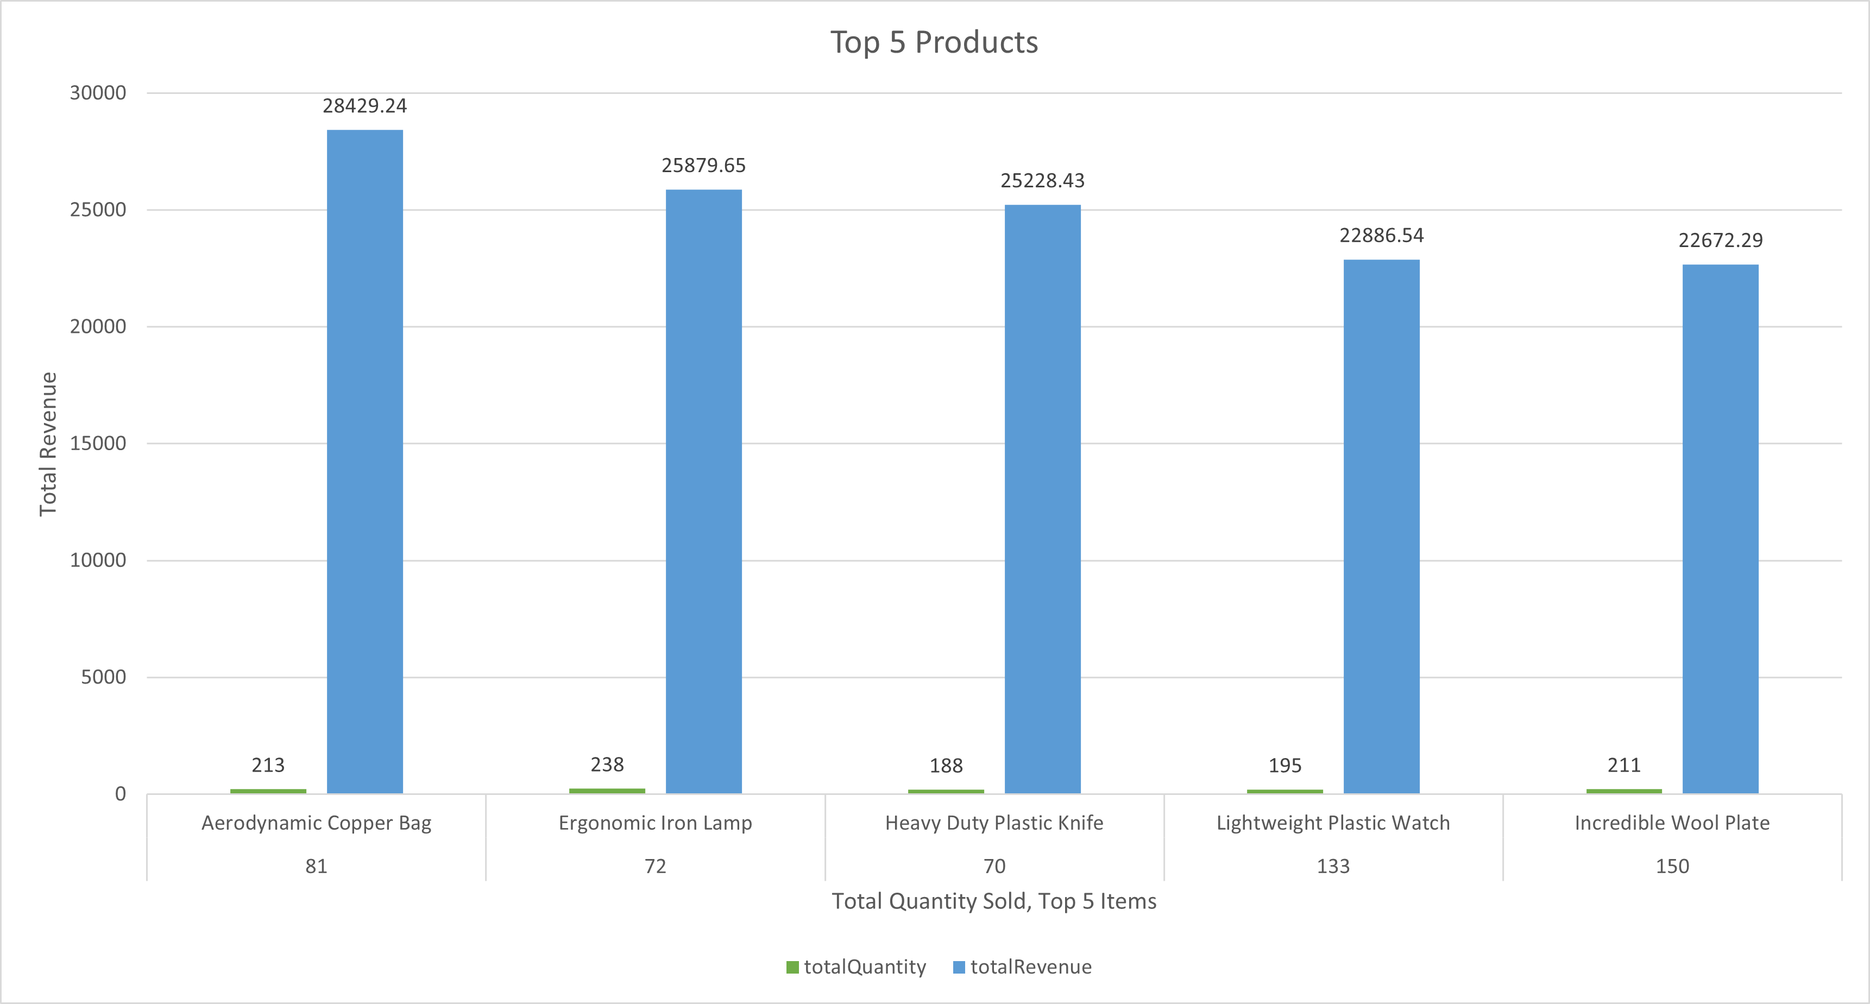
Top 5 products.

Slide 16
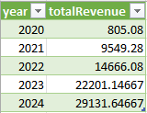
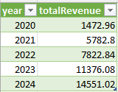
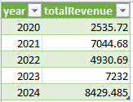
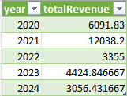
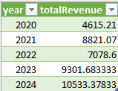
Top 5 Products 2023, 2024 Projections
Aerodynamic Copper Bag
Incredible Wool Plate
Lightweight Plastic Watch
Heavy Duty Plastic Knife
Ergonomic Iron Lamp

Slide 17
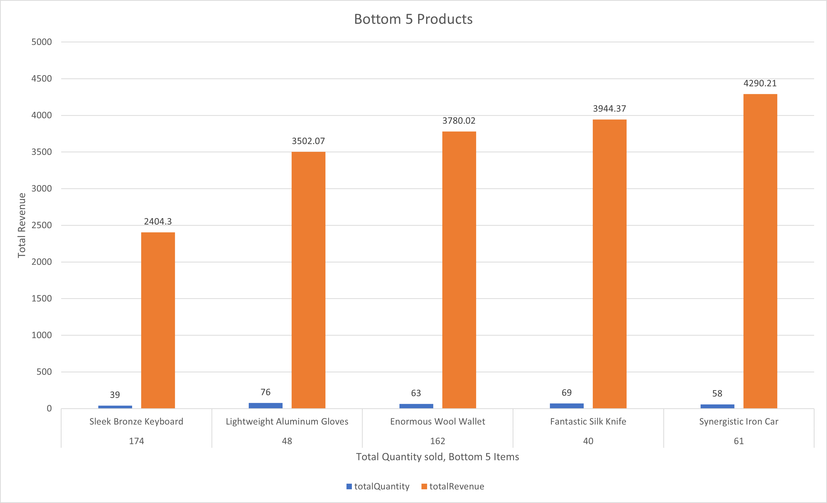
Bottom 5 products

Slide 18
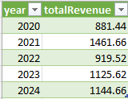
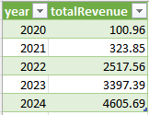
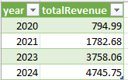
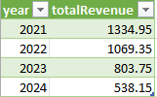
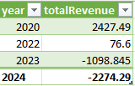
Bottom 5 products
Enormous Wool Wallet
Fantastic Silk Knife
Lightweight Aluminum Gloves
Sleek Bronze Keyboard
Synergistic Iron Car

Slide 19
Summary:
Looking at these products we should keep in mind that the top products should be stocked well and kept with a good level of inventory. With the bottom selling products it is advisable to not stock these items largely and to watch these items as it may not be worth it to even sell them, depending on margin or markup on these bottom items.

Slide 20
Payment Methods
It is important to know what the majority of your clients and customers are using for transactions to allow us to support the most users we can. We decided to evaluate the payment methods and project the future payment methods that will have the most usage and accumulate the number of orders.

Slide 21
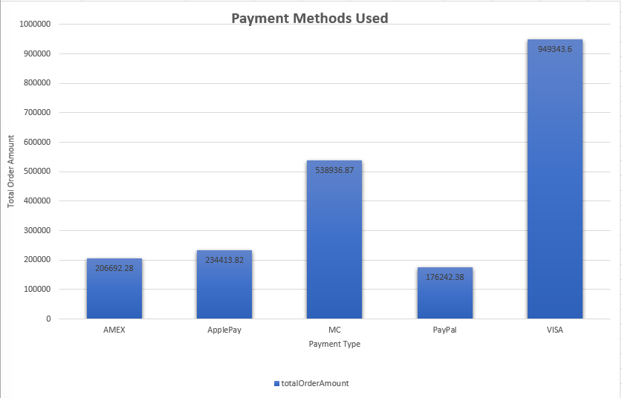
Payment Methods used in 2022

Slide 22
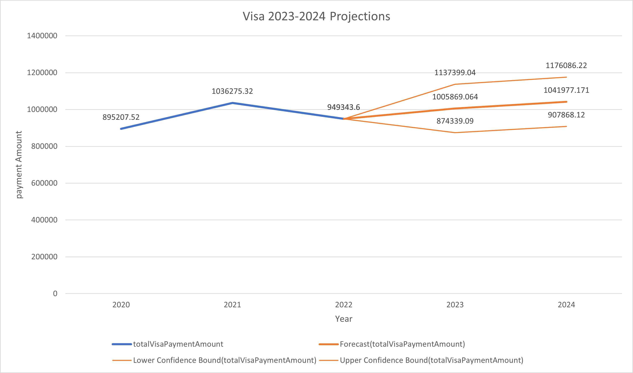
Visa Future predictions for 2024

Slide 23
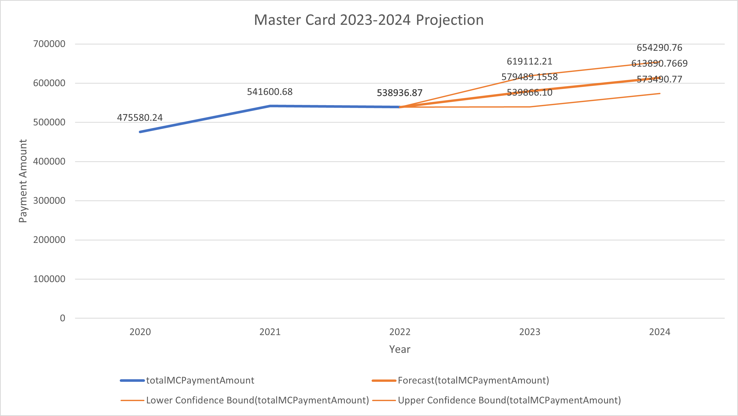
Master Card 2024 Prediction

Slide 24
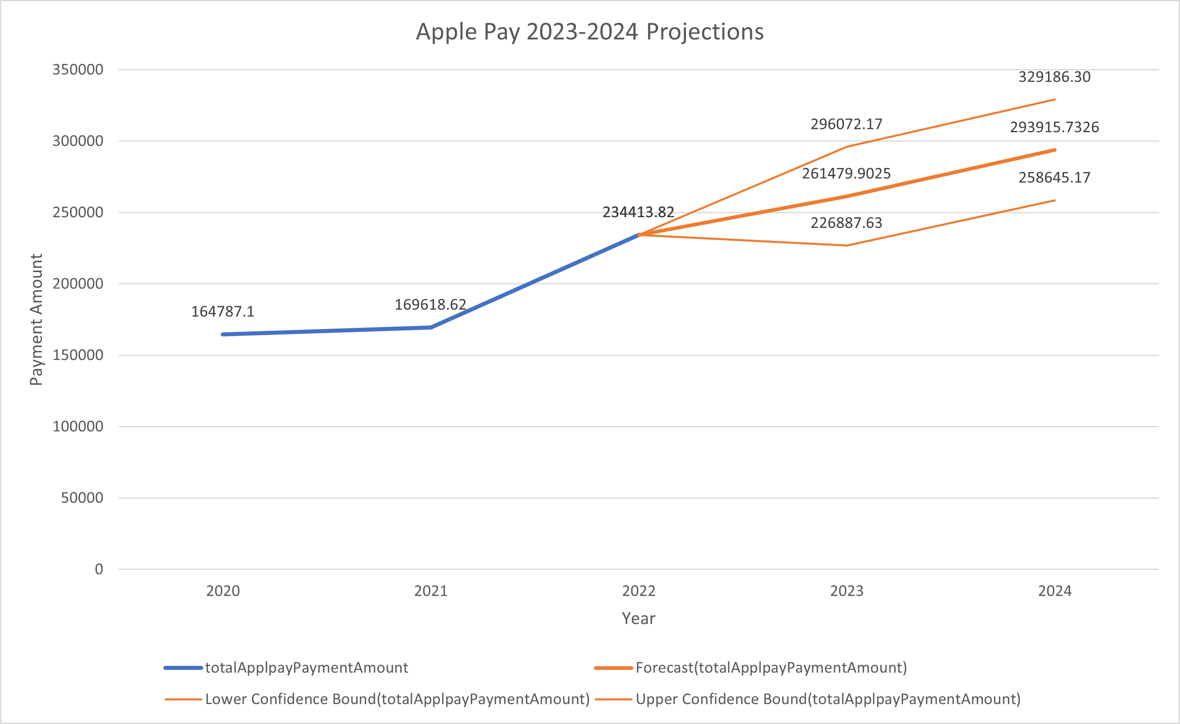
Apple Pay 2024 prediction

Slide 25
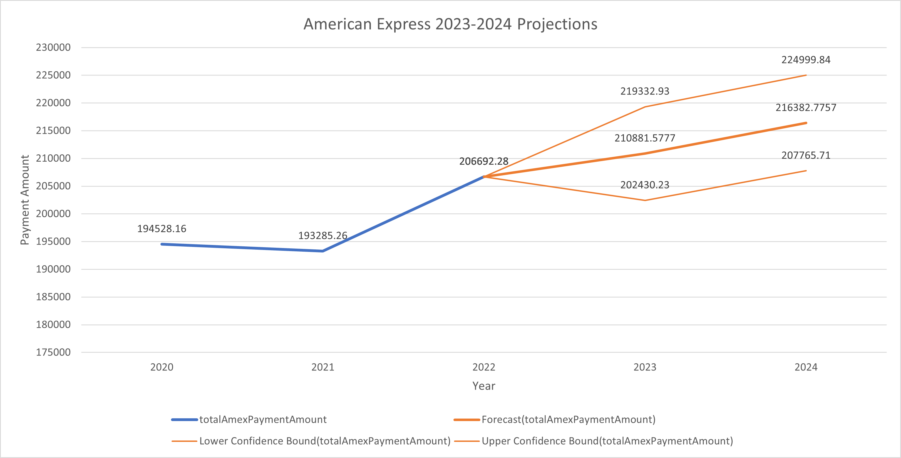
American Express 2024 Prediction

Slide 26
Pay Pal 2024 future prediction

Slide 27
Inventory Management
Finding what products sit on shelves the longest is an important stocking measure as some of these items take up large amounts of both space and overhead thus if we can limit the stock of these items, it can allow us to stock more important and higher margin items.
The Second Analysis is finding out what products have the best ratings; these ratings are important to us as we want to sell the best products that we can, and we want to be able to stand behind the quality of our products. In a world where the quality of products are constantly diminishing, we want to be at the forefront of good quality products.

Slide 28
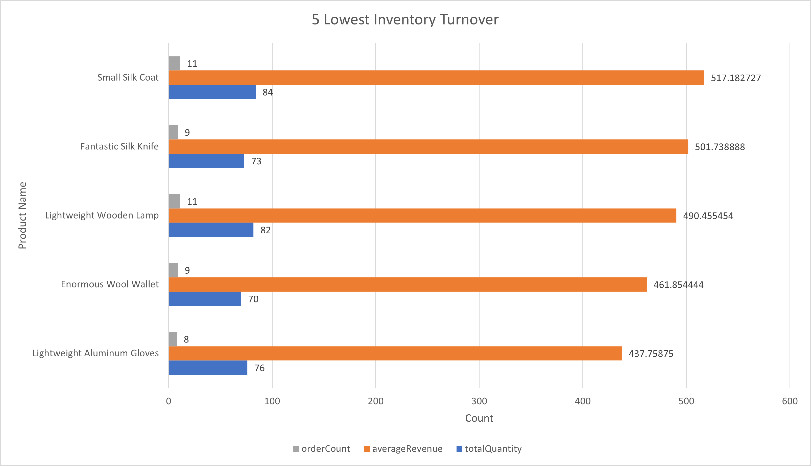
5 products with the Lowest inventory turnover

Slide 29
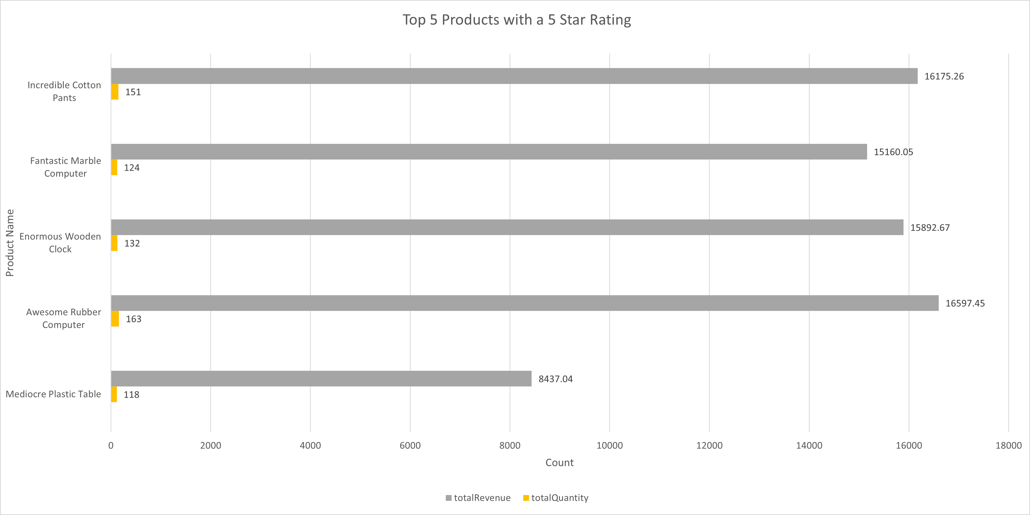
Top 5 products with a 5-star rating

Slide 30
Recomendation
Items with low turnover should be looked at and we should see if it is even worth it to stock these items and rather make them to order, as we could benefit from the space and replace these low selling items with higher margin and better selling items.
With the top 5 products with a 5-star rating, we should be ensuring that the quality from the supplier’s doesn’t drop on these items, and we should be in contact with the suppliers for any future changes to these products, also stocking these items and keeping some extra will be a wise move.

Slide 31
Our Choice Analysis
Finding our top customers who spend the most is important as we want them to feel recognized and we want to ensure that they are well taken care of, finding who these people are can allow us to send out rebates to them since they purchase so much as these rebates will allow them to purchase more in the future.
Projecting sales for the future years is an important metric as it ensures that we stay on the right path, since the projections for 2024 and 2025 are in the positive direction. We can assume that our sales tactics are working, and we do not need to change how things are being done, only focus on moving forwards and increasing sales volume.

Slide 32
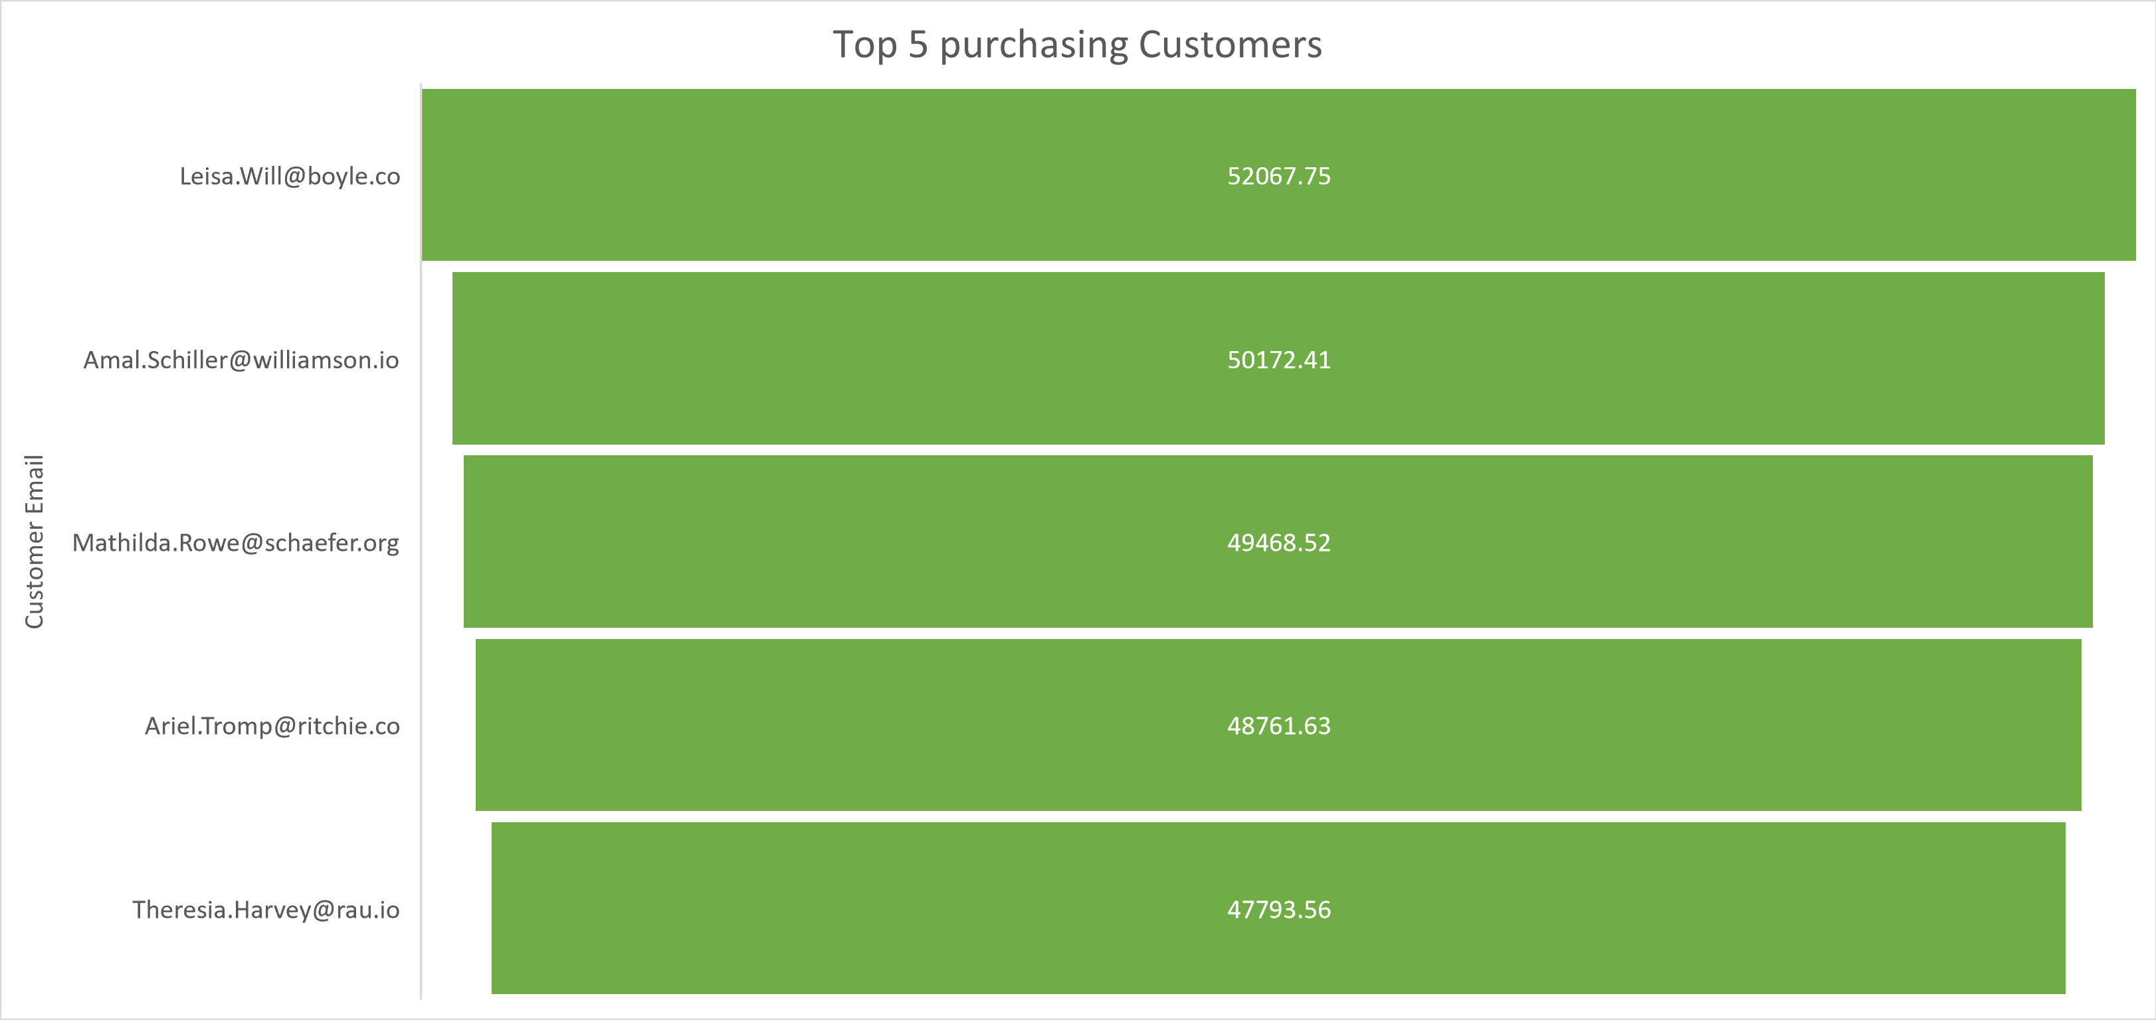
Top 5 Customers who spent the most amount

Slide 33
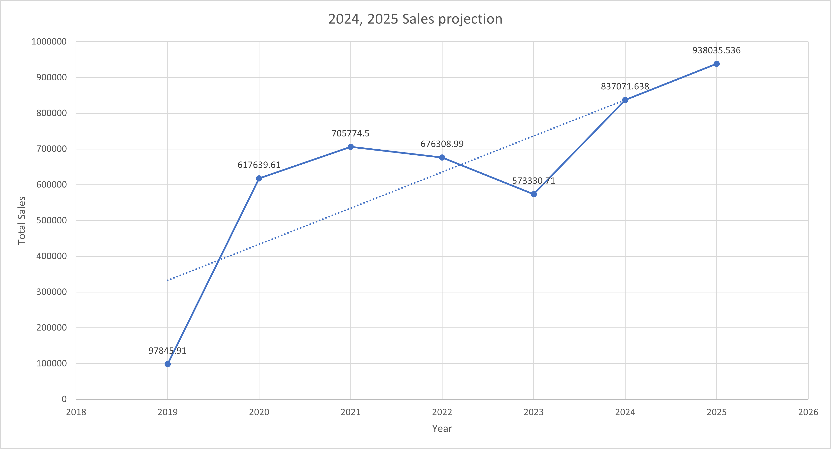
2024, 2025 sales projection

Slide 34
Recommendation
I suggest that for our top customers we invoke some sort of email that congratulates them, or we send over some promotional products over to them as we want to make these customers feel seen and we want to acknowledge their importance to us. We want to keep all of our customers happy, however those who spend the most are very important to us. We will not want to offer a credit system to these people as we will be watching rising interest rates.
Within our sales projections we need to ensure that our products are of top quality and ensure that we do not get lazy. With these projections we can see that we are on the right path.

Slide 35
Our choice analysis 2 : Quarterly analysis
Quarterly analysis allow us to do an in-depth dive into or company’s sales progress as simply annual assessments aren’t enough as we want more accurate and a more broken-down assessment as to our total sales progress. As you will see in the upcoming slides, we broke down each sales year starting from 2020 to 2023 to see what our sales amount was. Note that the Total sales is the dollar amount of our sales and not an item count. Also Note that the Quarter for Q4 in 2023 is not over, the cut off of the calculation was 10/28/23 [MM/DD/YYYY]

Slide 36
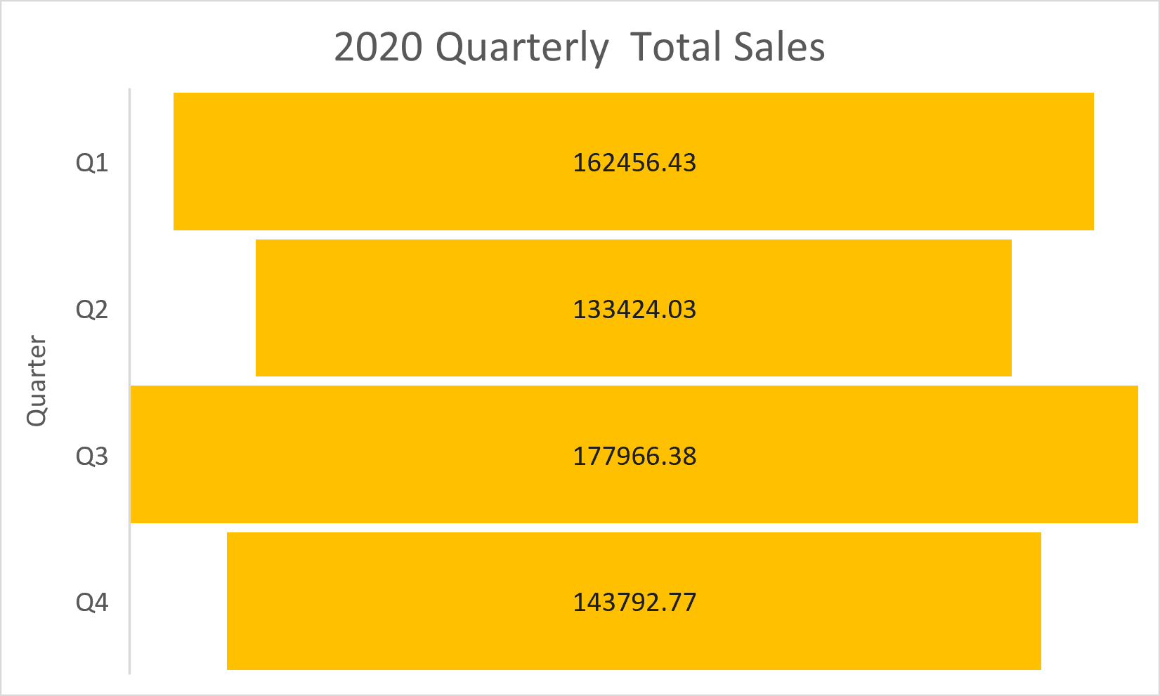

Slide 37
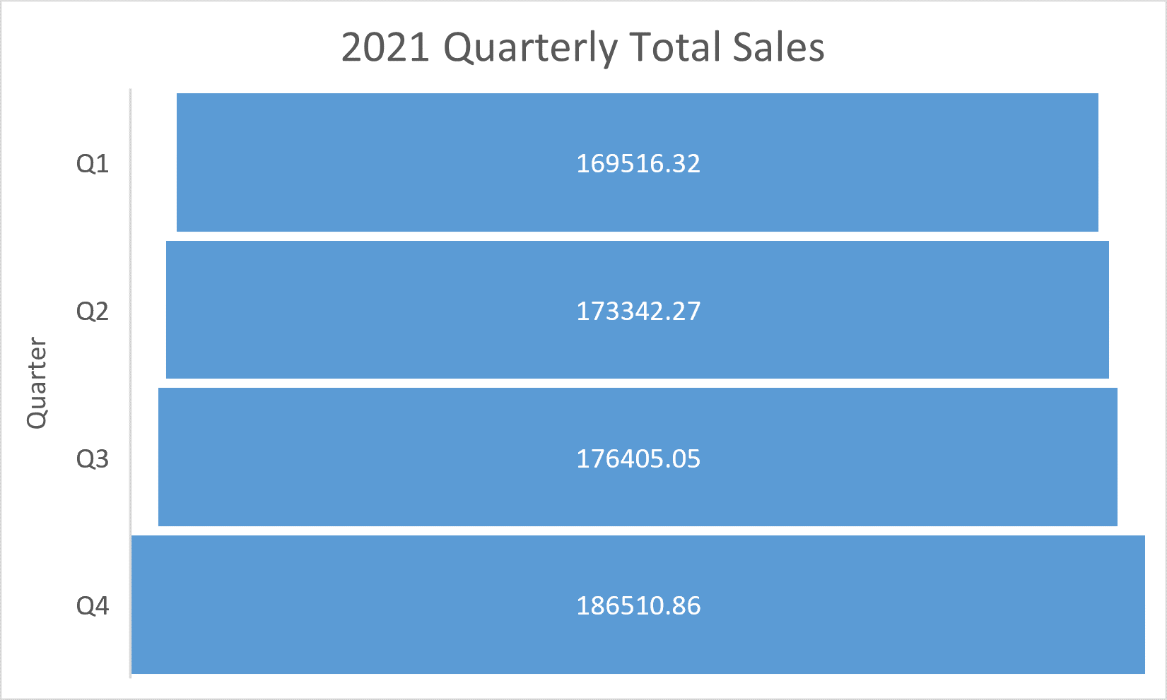

Slide 38
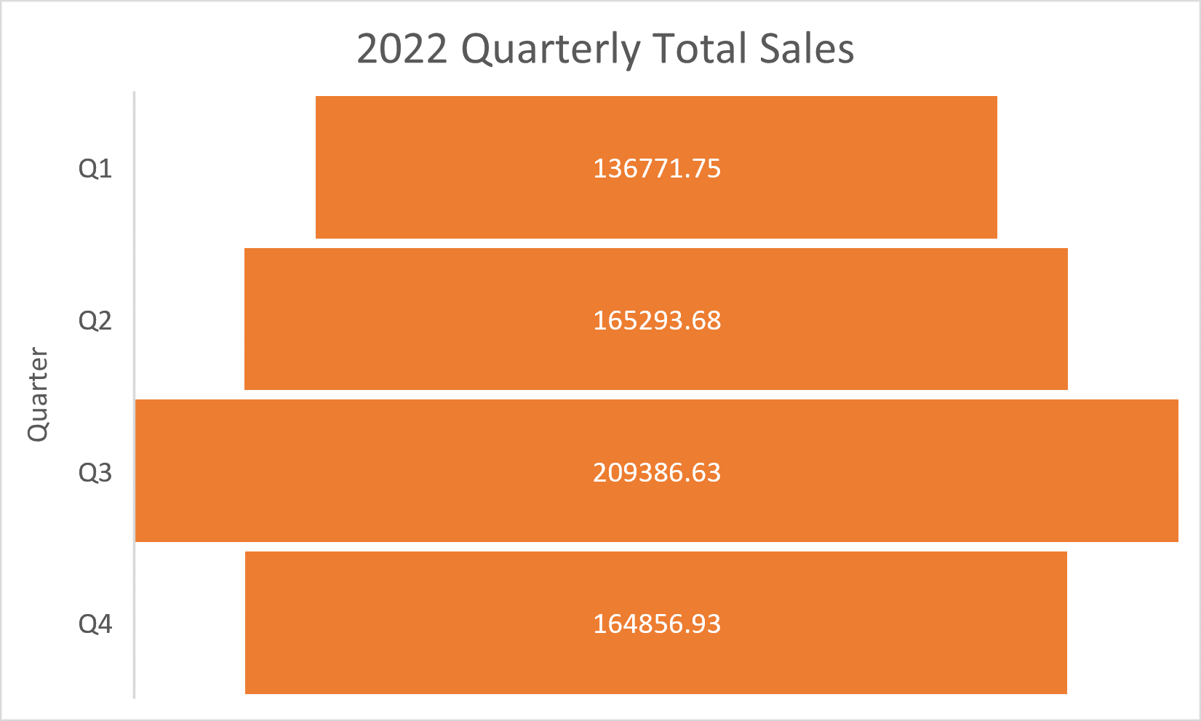

Slide 39
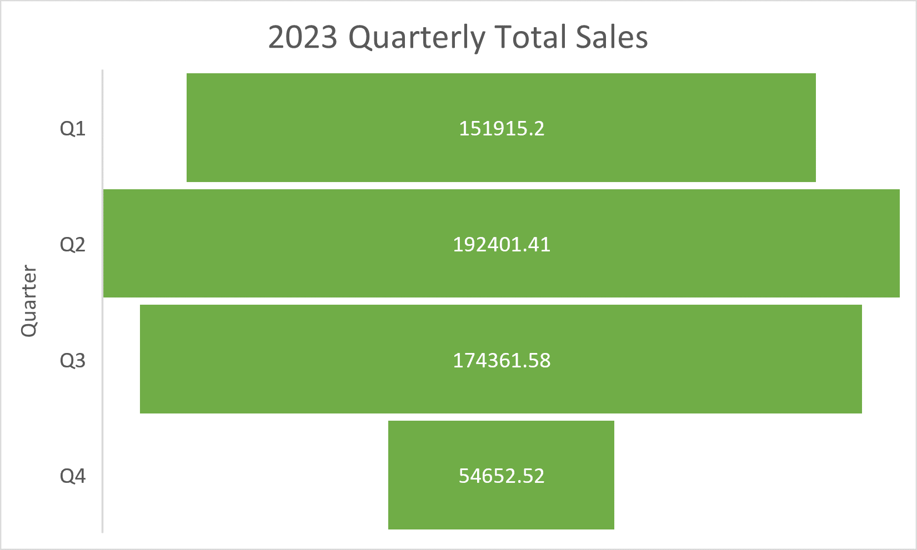

Slide 40
Recommendation
It seems like across the board we have grown each year and each quarter by sales amount, however 2022 Q4 was a slow quarter, perhaps it is worth it to look into that quarter a see what our sales volume was and how and when people were purchasing. Due to the nature of Interest rates nowadays we should see a decrease in sales as people begin to not have expendable income on non-primary items. We should continue to push forwards with our sales tactics and possibly watch out for credit card issues as people begin to stretch themselves thin.

